Slide 1
CST 499: Final Project student portal presentation
Heather Seymour
CST 499 Capstone for Computer Software Technology
Carmelia Butler
January 27, 2025

Slide 2
Agenda
Key aspects of the Software Requirements Specifications (SRS)
UML design models
Design of Student Portal pages
MySQL database and class registration
PHP code

Slide 3
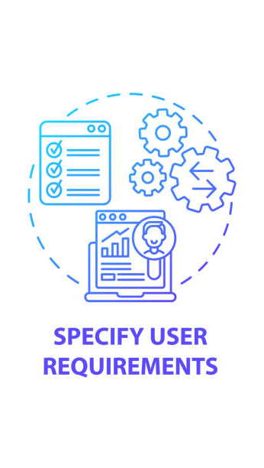
SOFTWARE REQUIREMENTS SPECIFICATIONS (SRS)
Purpose
Specifies functional and non-functional requirements for the Student Portal system (Tsui, et al., 2018)
Scope
Features: user registration and authentication, login, course enrollment, waitlist management, and notifications
Users: students, instructors, administrators

Slide 4
Functional and non-functional requirements
Functional Requirements
User registration and login, course enrollment, waitlist management, and waitlist notification system
Non-functional Requirements
Handle multiple users effectively, secure user data, user-friendly interface

Slide 5
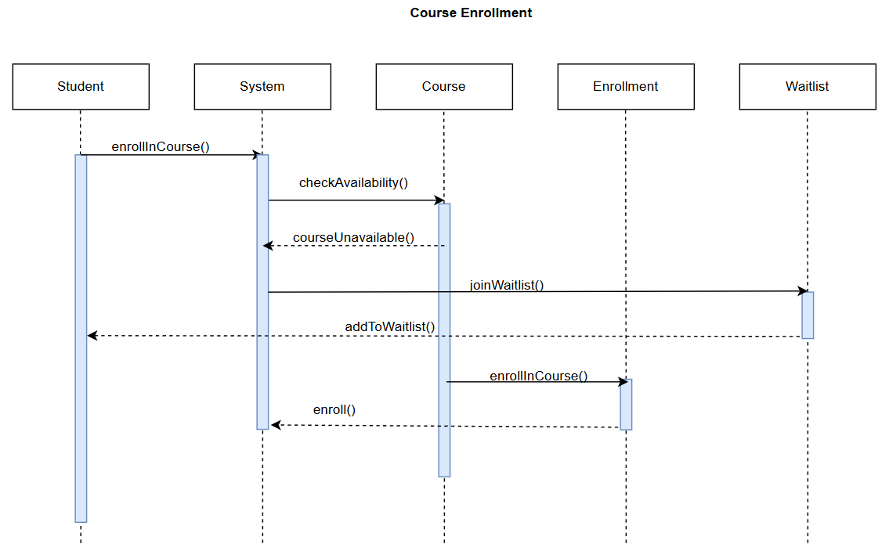
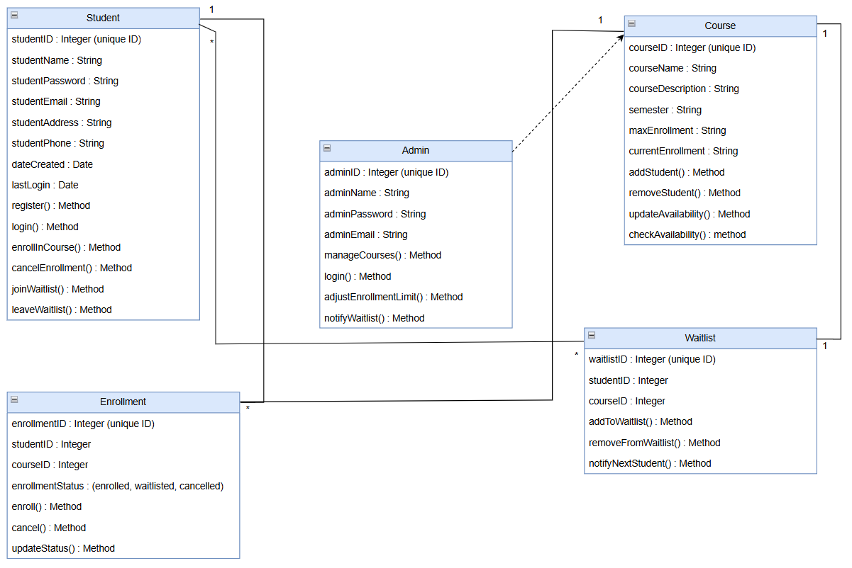
SEQUENCE DIAGRAM
Class diagram
Relationships
Attributes and methods
Flow of course enrollment process
Interface, database, and backend interactions

Slide 6
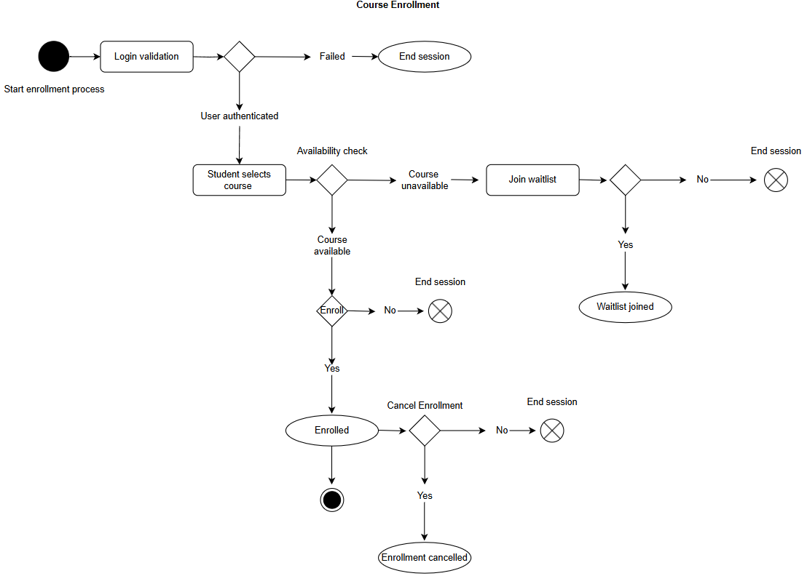
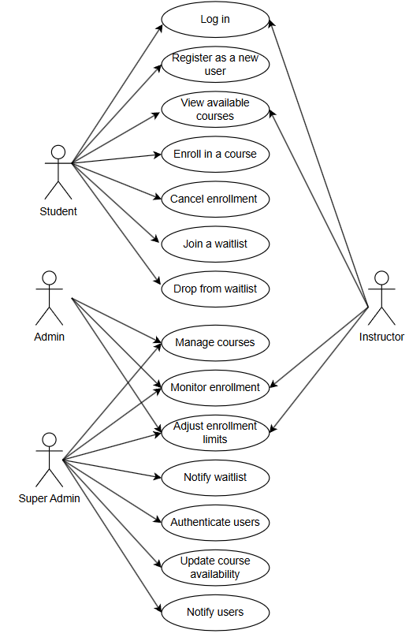
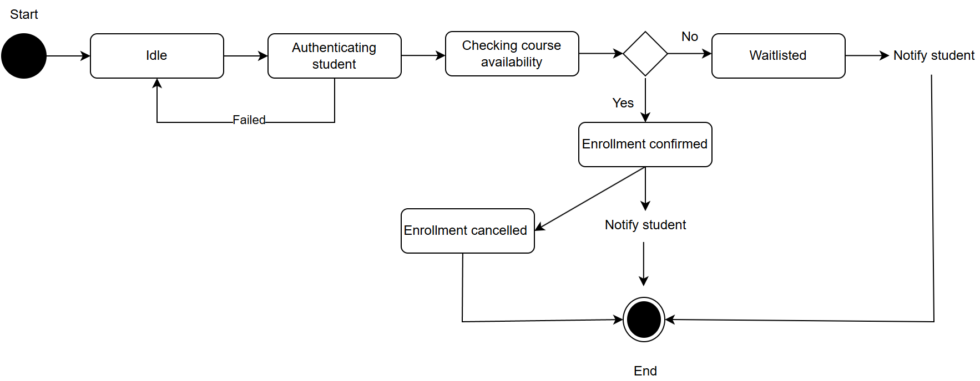
STATE
USE CASE
ACTIVITY
User interactions
Key functions
Course enrollment and waitlist handling process
States
Transitions

Slide 7
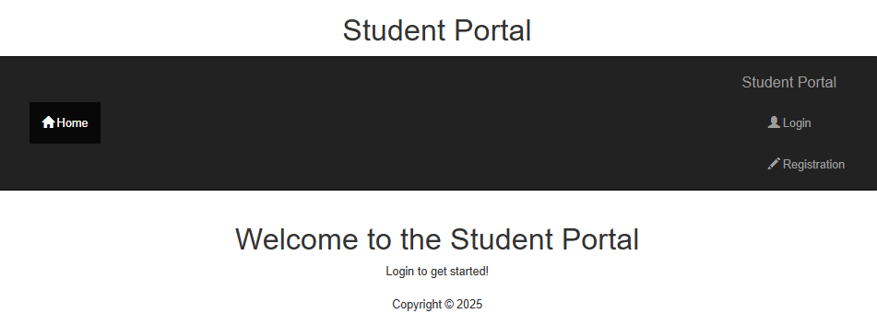
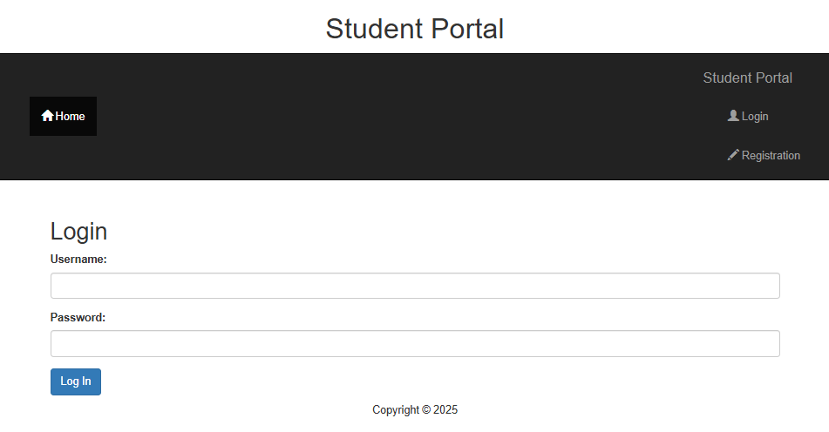
Landing and login pages
Landing page
Layout
Navigation (W3 Schools, n.d.a)
Login page
Validation mechanisms (Connolly & Hoar, 2022)
Secure password handling

Slide 8
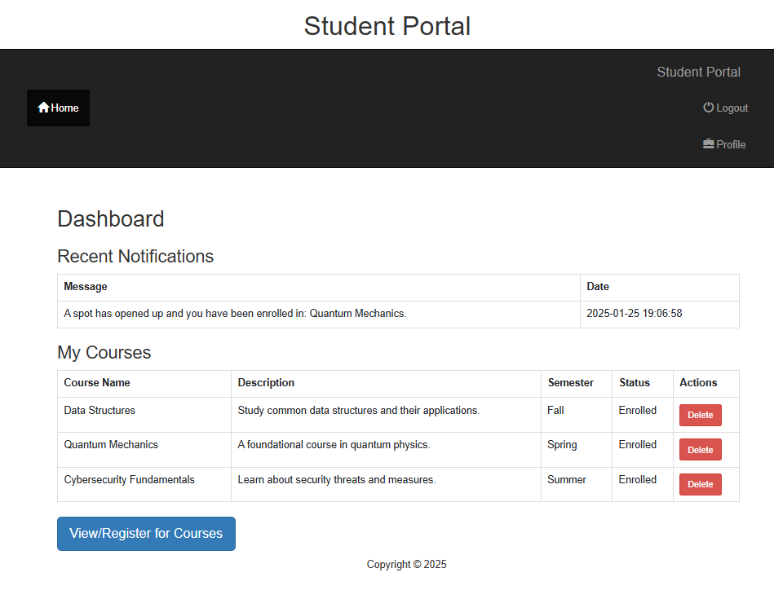
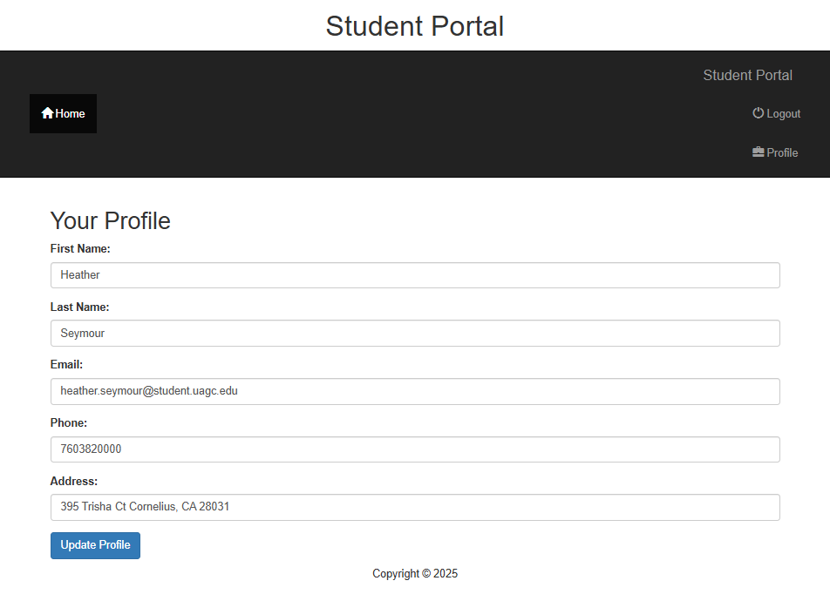
dashboard and profile pages
Dashboard
Layout (W3Schools, n.d.b)
Navigation
Profile management
Update information (Connolly
& Hoar, 2022)
Database interaction
(W3Schools, n.d.c)

Slide 9
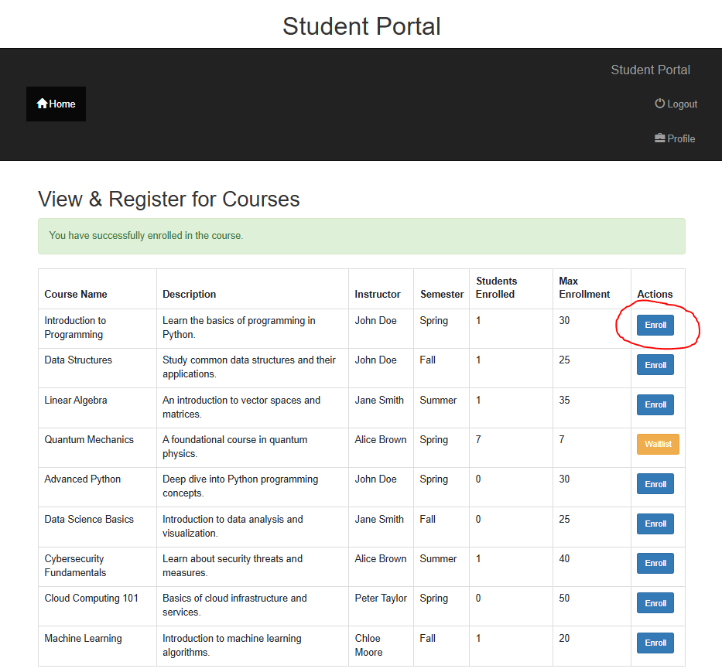
CLASS REGISTRATION
Process Flow
Users view available courses, enroll in open spots, or join the waitlist.
Dynamic updates – Enrollment counts and waitlist notifications
Key SQL Commands (W3 Schools, n.d.c):
INSERT – enrollments and waitlists
DELETE – unenrollment and waitlist removals
UPDATE – enrollment count adjustments

Slide 10
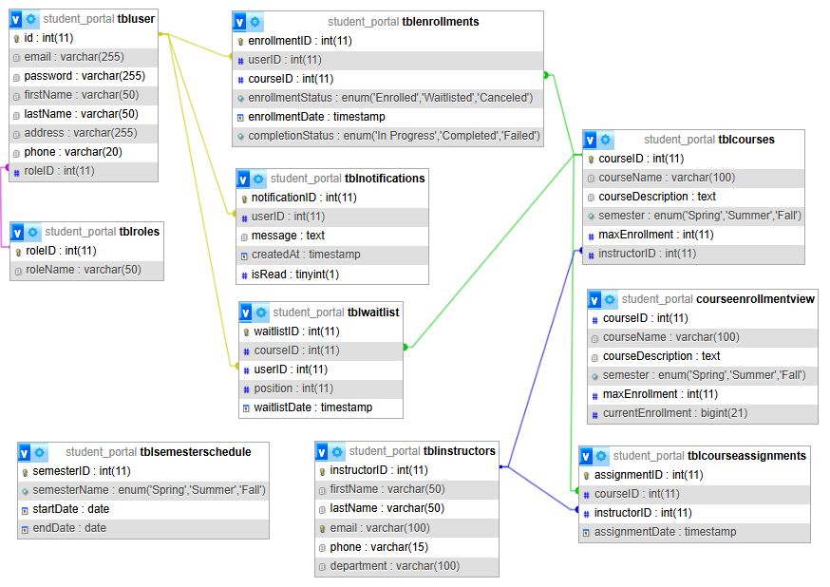
DATABASE DESIGN
Key tables: tblUsers, tblCourses, tblEnrollments, tblWaitlist, tblNotifications
Relationships: foreign keys link users, courses, enrollments, and instructors
Enrollment count update dynamically based on users’ actions
Waitlist functionality – automatic notification and enrollment for next-in-line

Slide 11
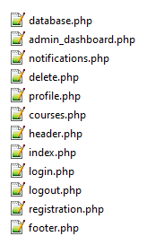
PHP CODE
Database connection (database.php)
PDO (PHP Data Objects)
Centralized class = consistent interactions
Notification system (notifications.php)
Reusable PHP functions

Slide 12
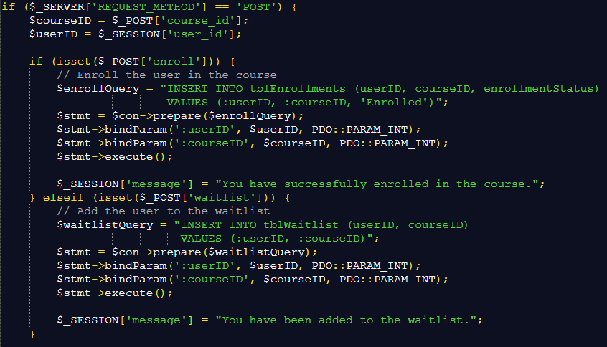
PHP CODE (cont.)
Enrollment Process: PHP code ensures users are enrolled if spots are available.
Tracks currentEnrollment dynamically (W3 Schools, n.d.b)
courses.php
Waitlist Handling: Add users to the waitlist if a course is full
PHP logic updates the database and sends notifications when spots open

Slide 13
References
Connolly, R., & Hoar, R. (2022). Fundamentals of web development (3rd ed.). Pearson.
Tsui, F., Karam, O., & Bernal, B. (2018). Essentials of software engineering (4th ed.). Jones & Bartlett Learning.
W3Schools. (n.d.a). HTML5 tutorial. https://www.w3schools.com/html/
W3 Schools. (n.d.b) PHP tutorial. https://www.w3schools.com/php/default.asp
W3 Schools. (n.d.c) SQL tutorial. https://www.w3schools.com/sql/

Slide 14
Thank you!
Heather Seymour
heather.seymour@student.uagc.edu

